Slide 1


Slide 2
Project name and team members
You tube channel
Team Id: NM2023TMID13480
By
J.Ananthika
B.Arthy
R.Aswitha
T.Deepika
File created on:14.10.2023

Slide 3
Introduction
Our Project is exploring the world's top you tube channel in India.
The collection of world's top you tube channel in india and the data.

Slide 4
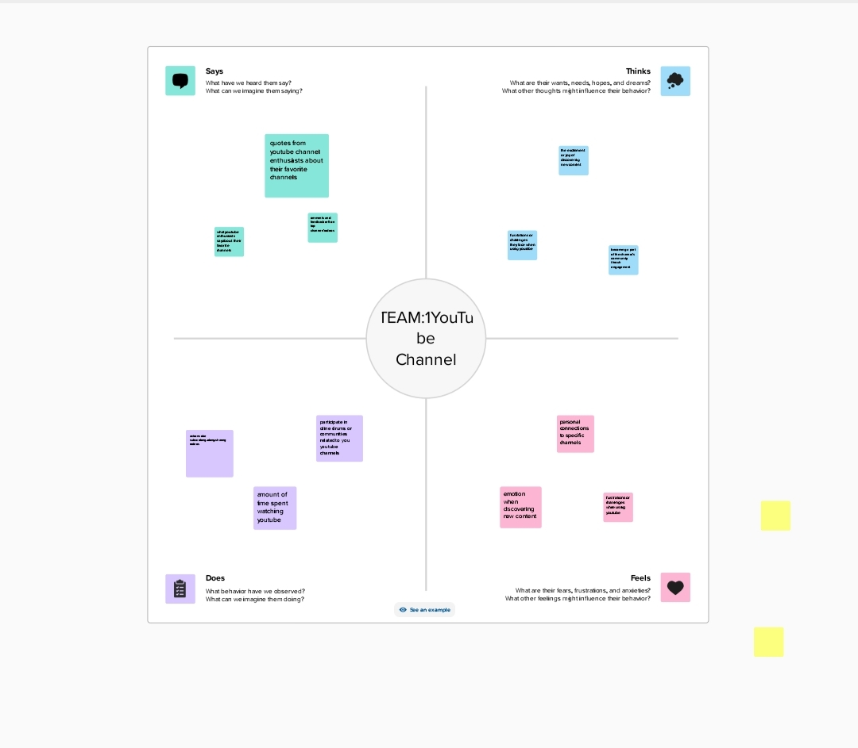
PROBLEM DEFINITION AND DESIGN THINKING
Empathy Map:

Slide 5
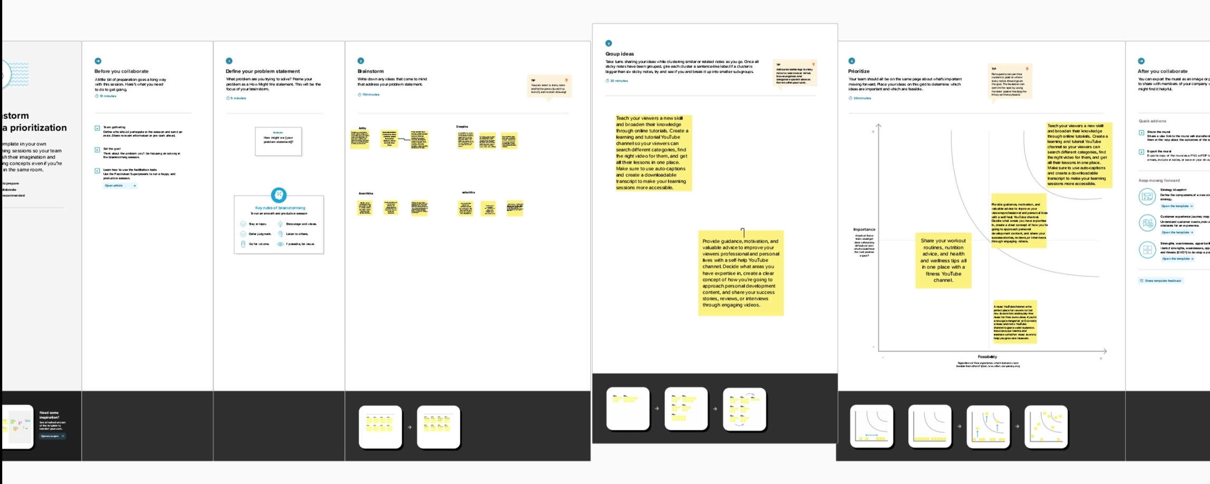
BRAIN STORMING

Slide 6
RESULT
Finally finding output of the project along with screenshot.

Slide 7
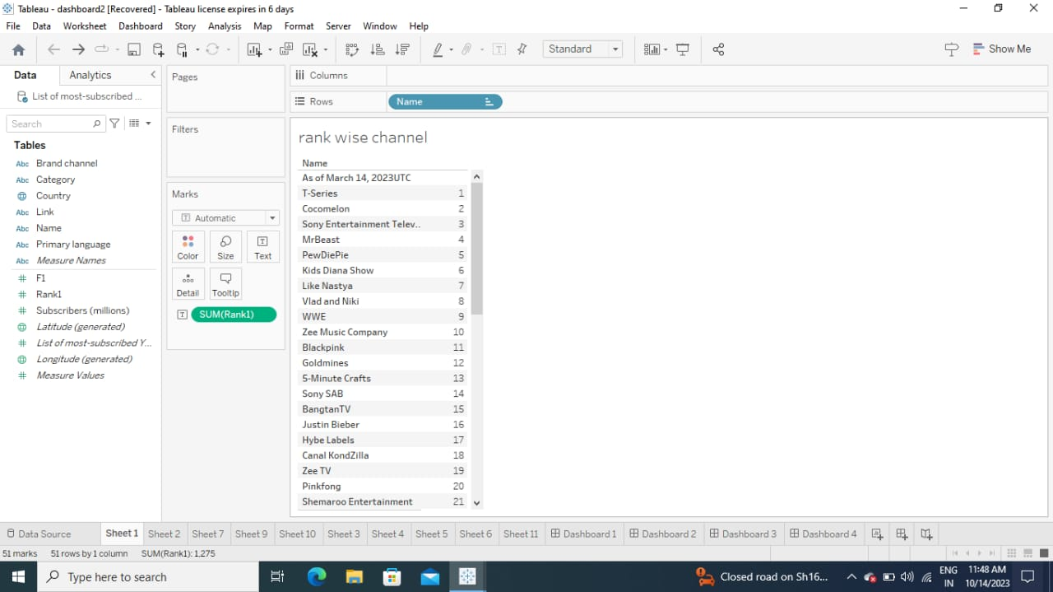
SHEET 1:
This picture showing rank wise top you tube channel in various city

Slide 8
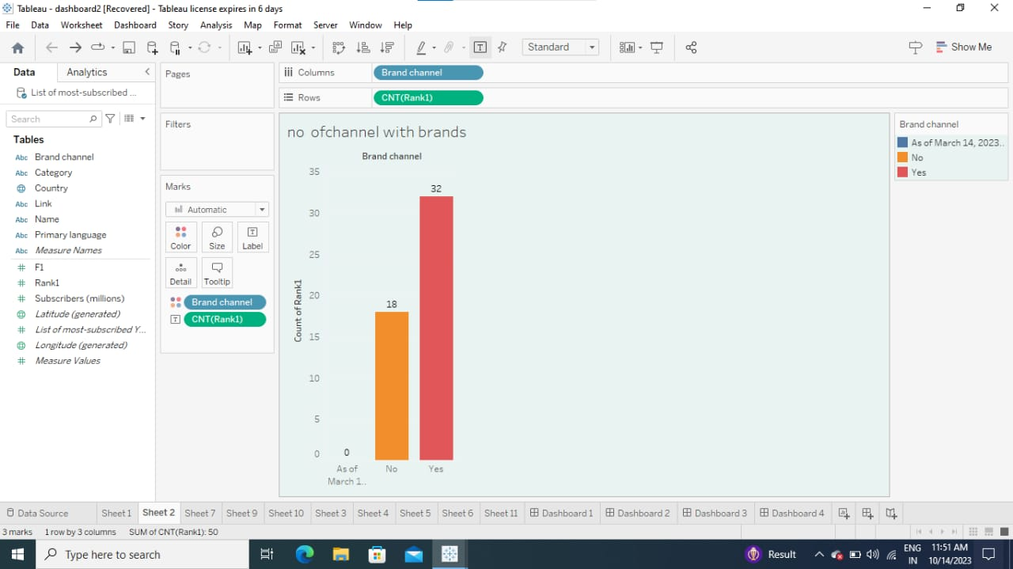
SHEET 2:
Bar graph showing no of channels with brands.

Slide 9
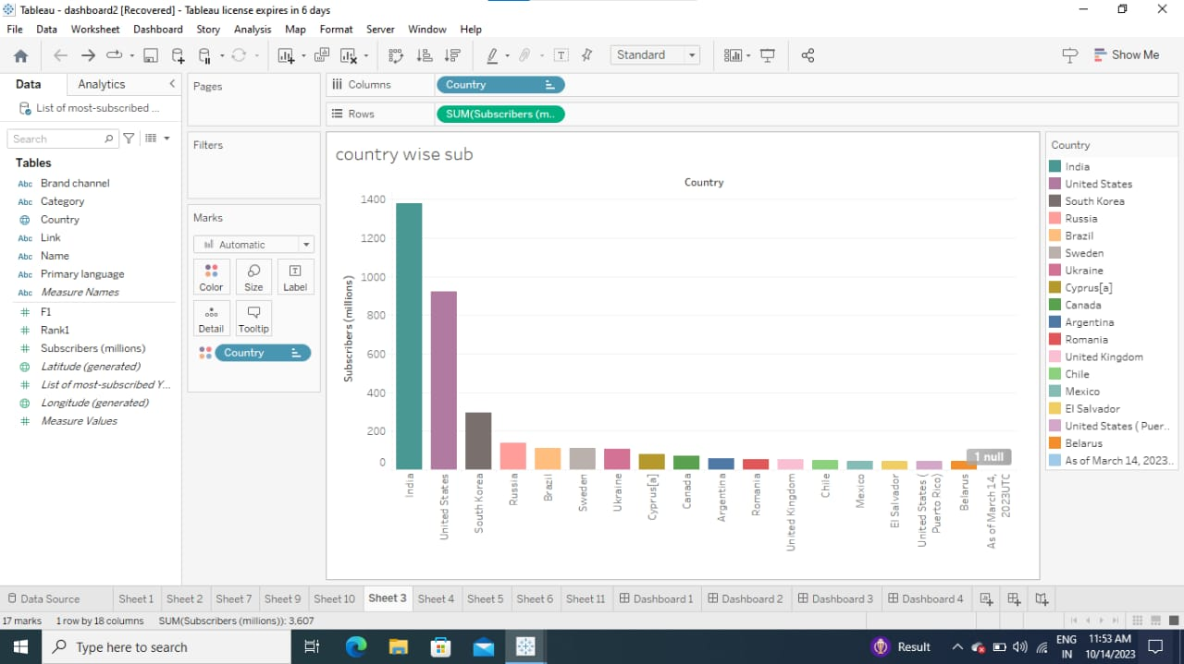
SHEET 3:
This bar diagram shows country wise subscribes .

Slide 10
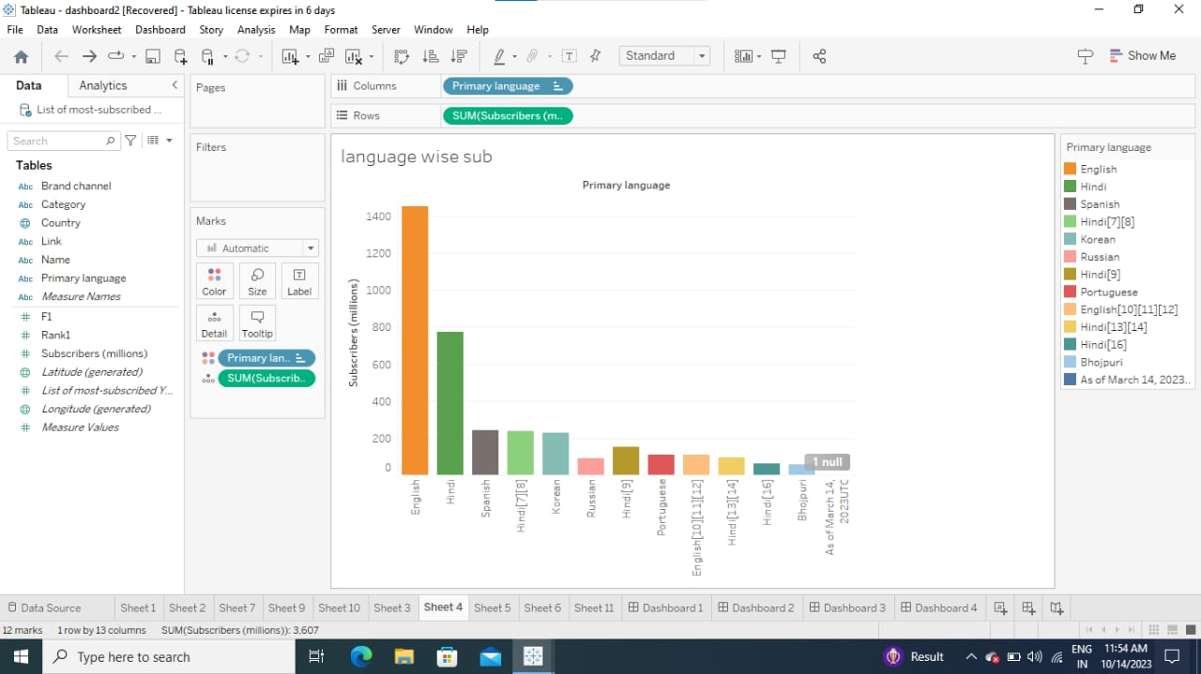
SHEET 4:
This bar diagram shows language wise subscribein india.

Slide 11
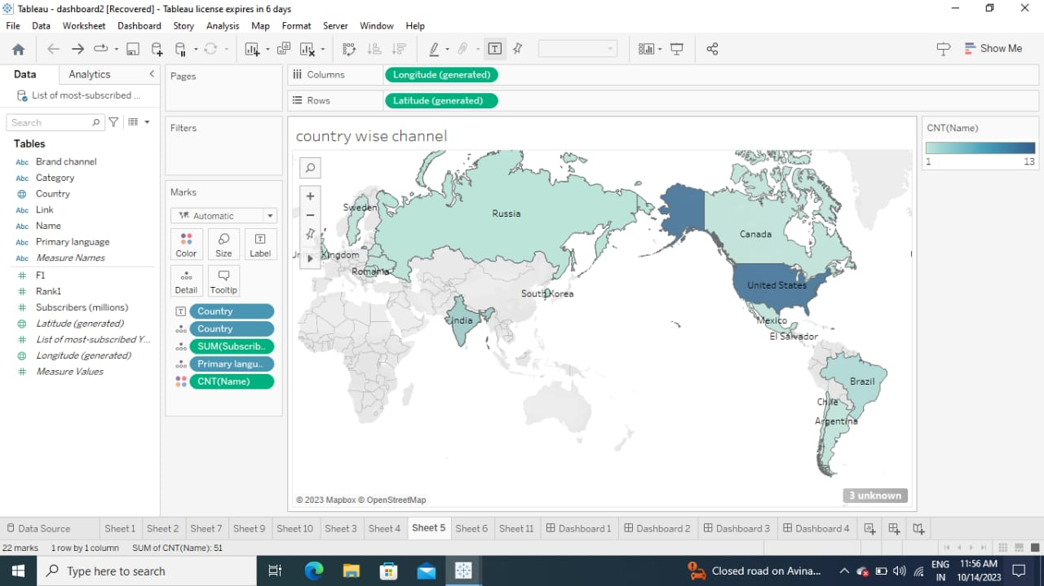
SHEET 5:
Map showing country wise channel.

Slide 12
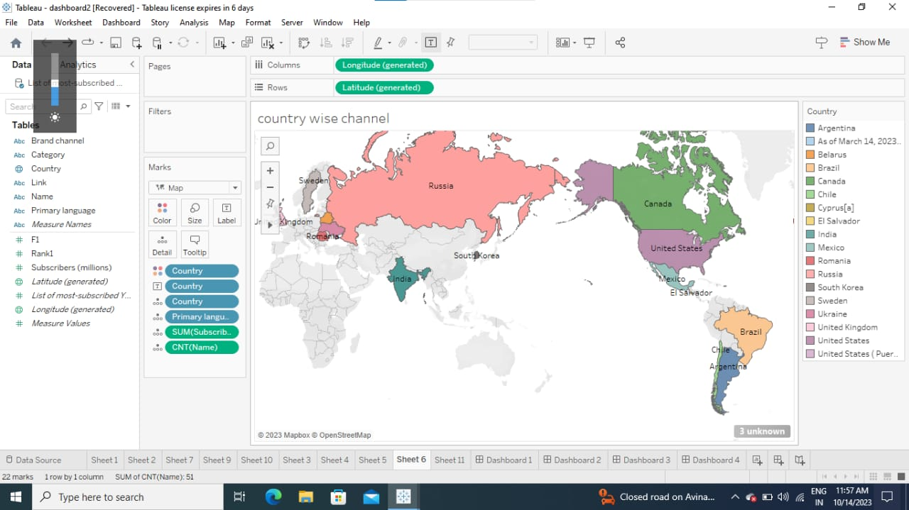
SHEET 6:
Map showing country wise channel.

Slide 13
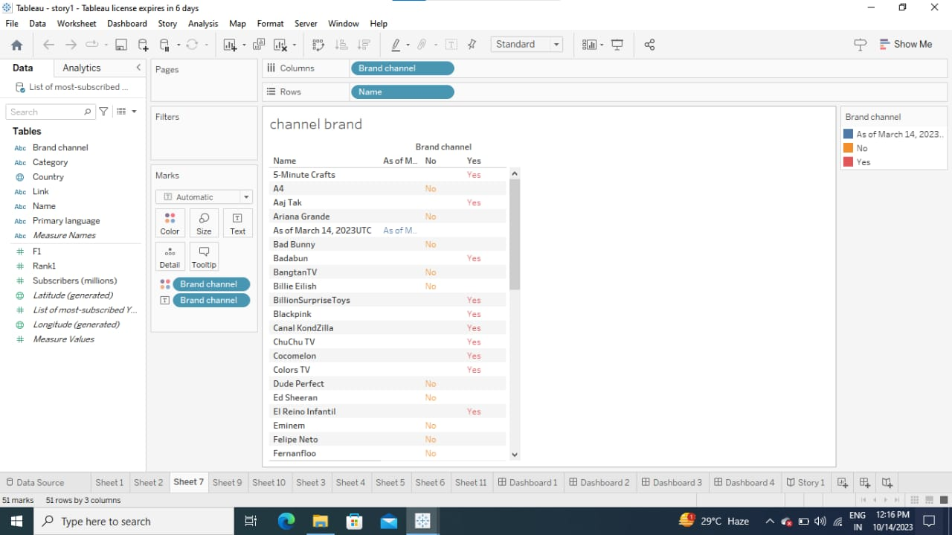
SHEET 7:
This picture shows the channel brand.

Slide 14
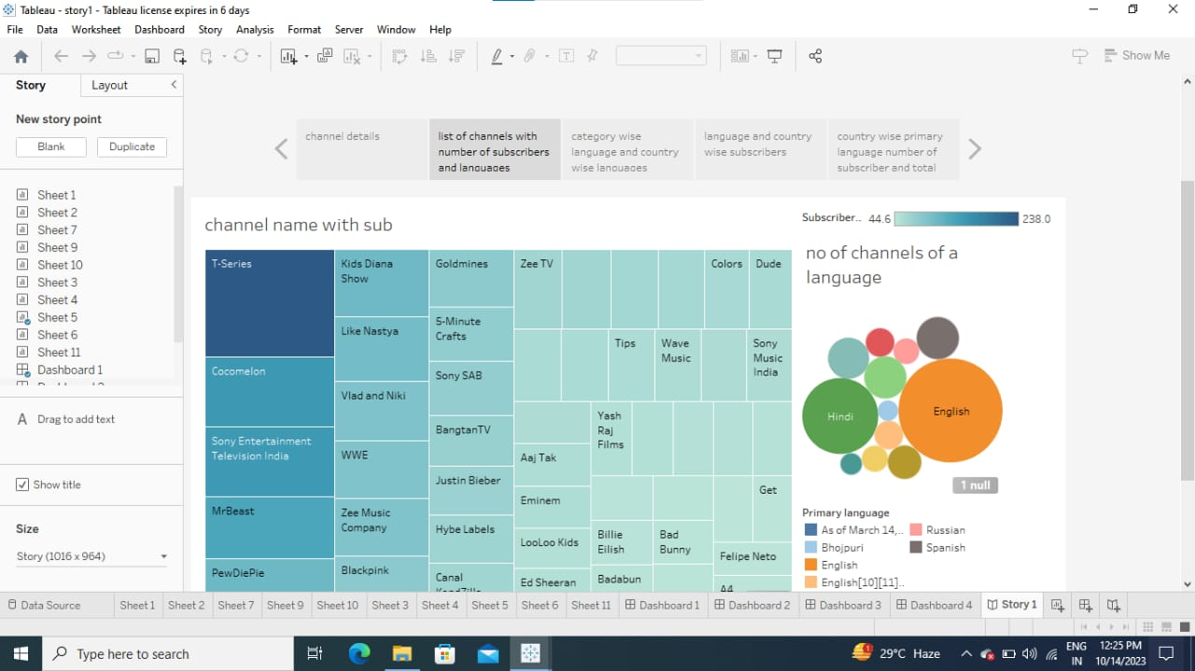
SHEET 8:
This picture shows the channel name with subscribes.

Slide 15
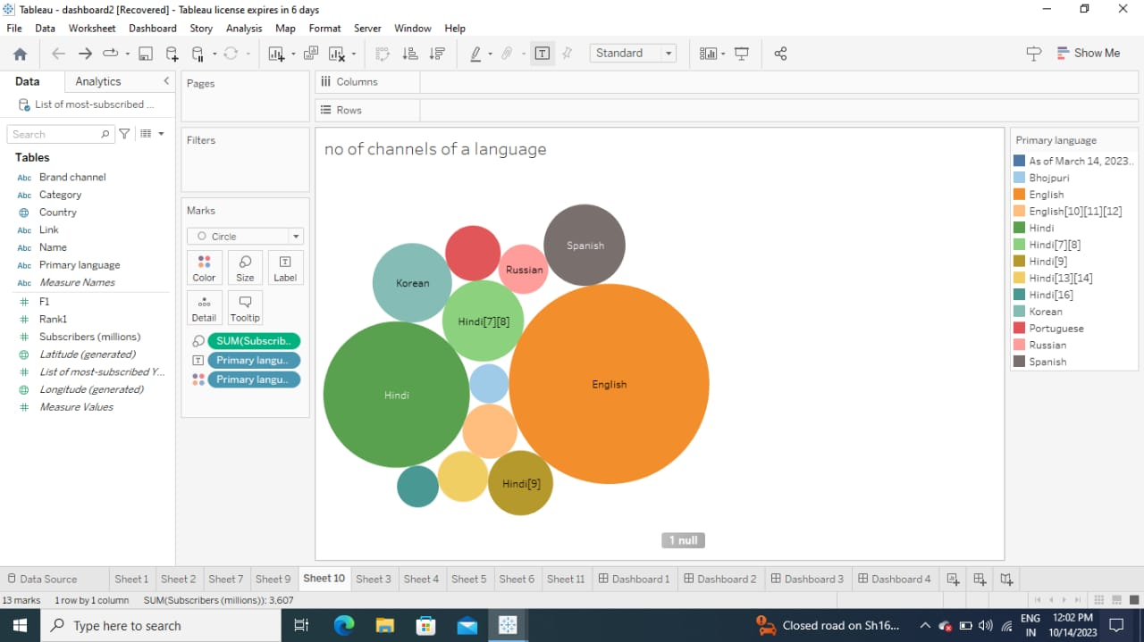
SHEET 9:
This picture shows no of channels of a language.

Slide 16
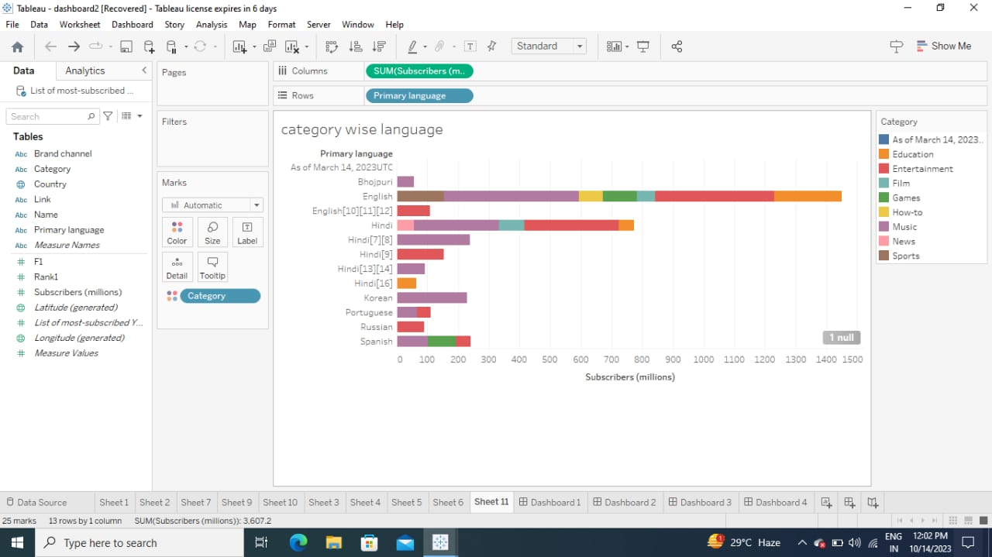
SHEET 10:
This picture shows category wise language

Slide 17
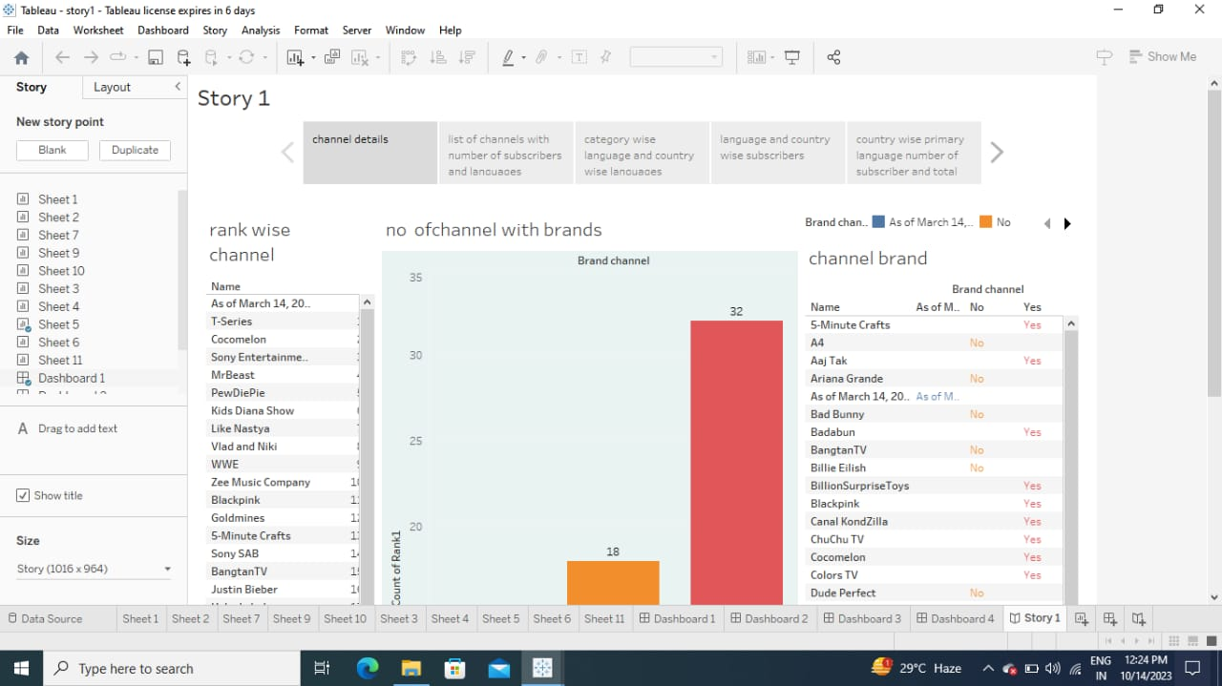
DASHBOARD 1:

Slide 18
DASHBOARD 2:

Slide 19
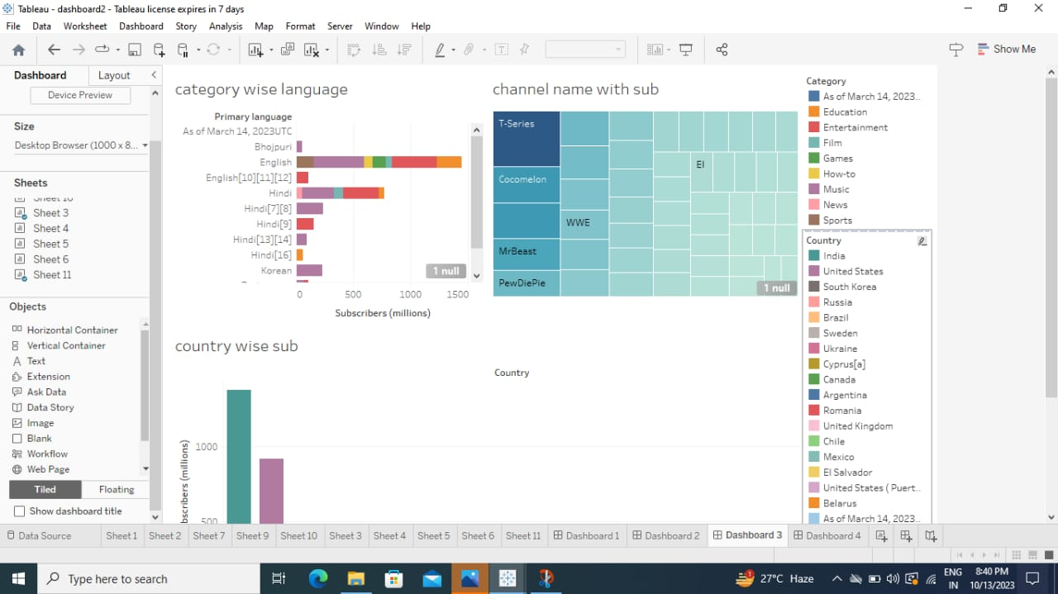
DASHBOARD 3:

Slide 20
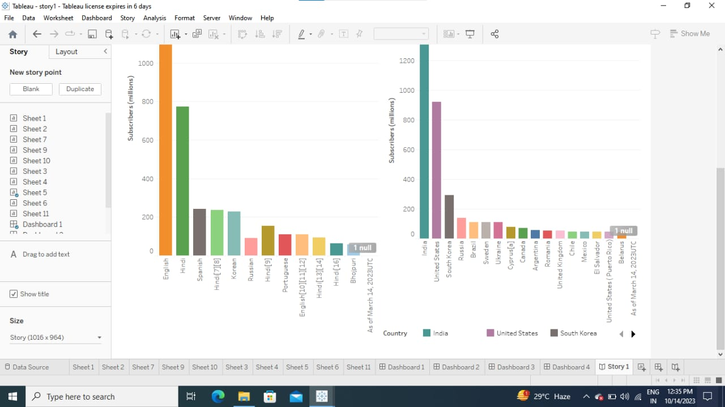
DASHBOARD 4:

Slide 21
STORIES

Slide 22
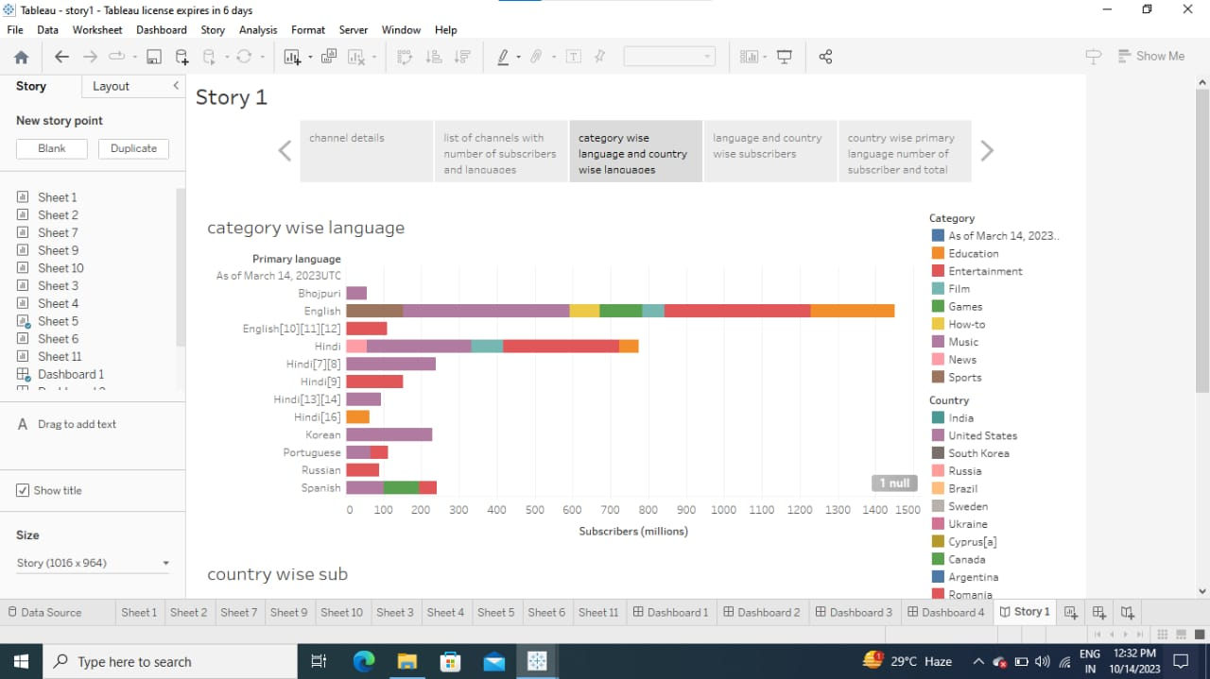
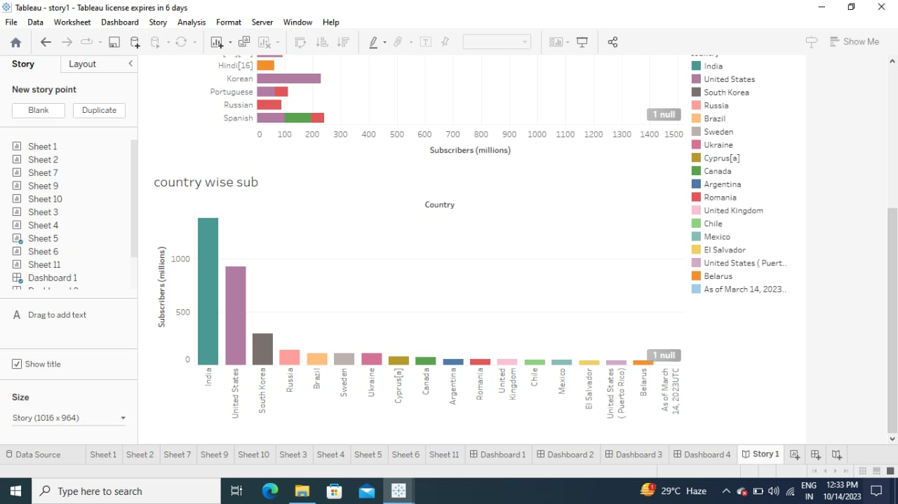

Slide 23
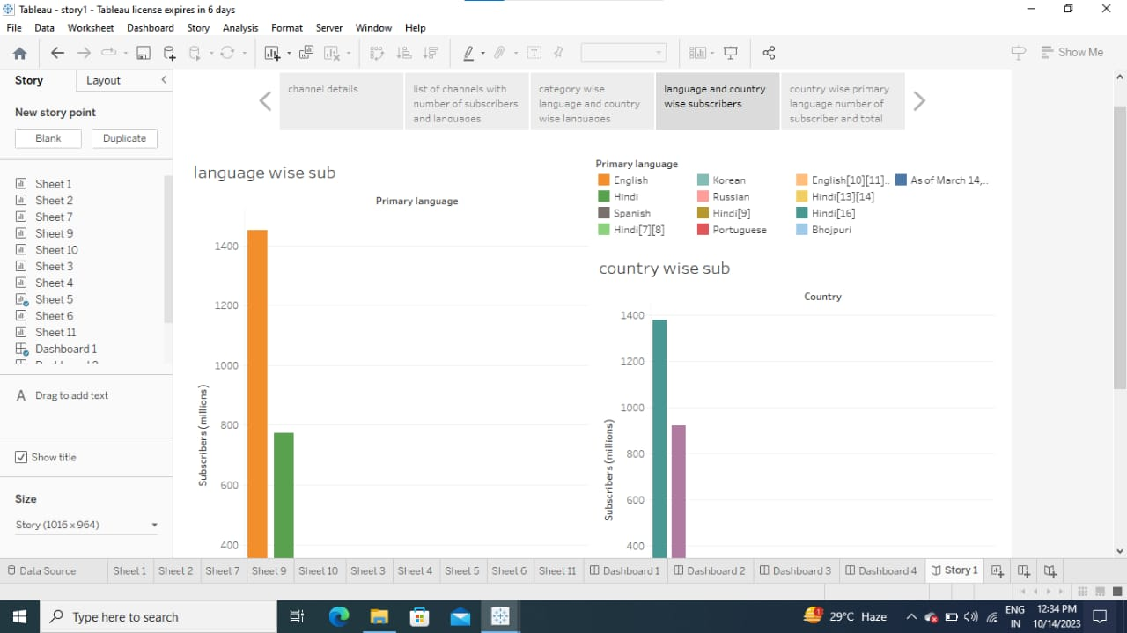

Slide 24
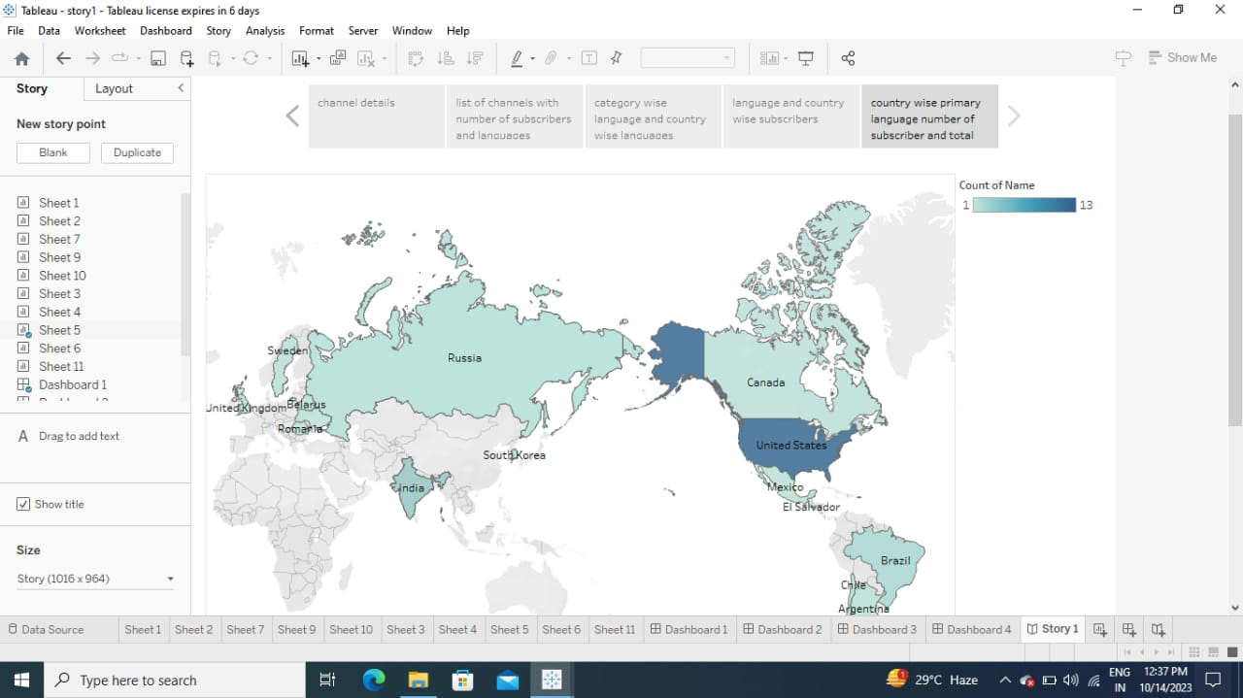

Slide 25
GITUP LINK :
EMPATHY AND BRAIN STORMING
https://github.com/Deepikathiru640/Youtube_Channel_Team1
TABLEAU PUBLISH
https://public.tableau.com/app/profile/ashwitha.r/vizzes
OVER ALL TABLEAU WORK
https://public.tableau.com/app/profile/ashwitha.r/vizzes

Slide 26
Uses
Creative self-expression. Making videos on YouTube is a great opportunity for creative self-expression. And it doesn't matter what exactly you are doing, filming a thoughtful show, leading a lifestyle blog, or doing translations. Creativity in any form saturates life with new colors.
Conclusion:
In future the analysing of world's top you tube channel is helpful for the people who want to fulfill her dream.

